Slide 1


Mediator

Slide 2

Jack's story
This is Jack
Jack is 4 years old
Jack loves his father and is the best person in his life after losing his mother

Slide 3
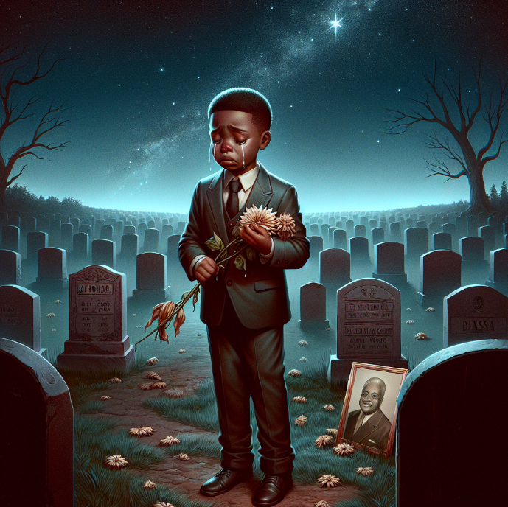
Jack's story
Jack lose his father
Jack’s father take 2 drugs conflicting medication

Slide 4
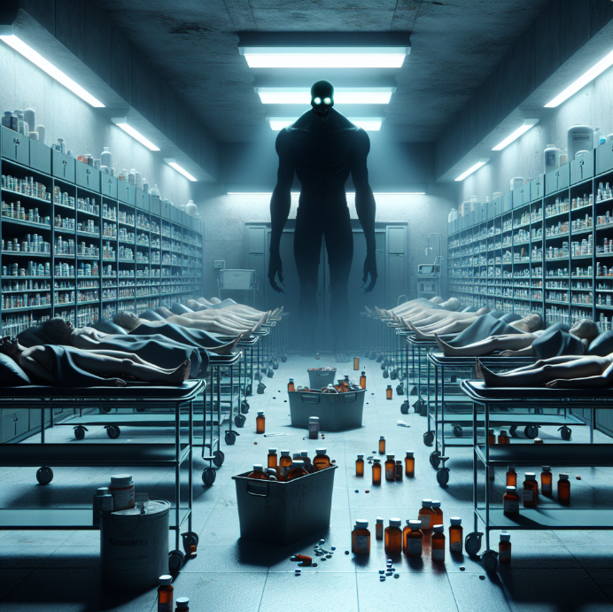
Global statistics
Global Health Organization
135,700,00 Emergency cases
250,000 Drug conflicts in USA in 2019
1250 people died 0.5%

Slide 5

Mediator

Slide 6

Mediator
An intermediary between
the patient and the doctor
Record the patient's medical history
Medication conflicts

Slide 7

Pneumonia:

Slide 8

Search for
patient data

Slide 9


Conflicting medication

Slide 10

Non-contradictory medication

Slide 11


Diagnosis with
mediator

Slide 12
Collaboration
between Drs

Slide 13
ER Diagram

Slide 14
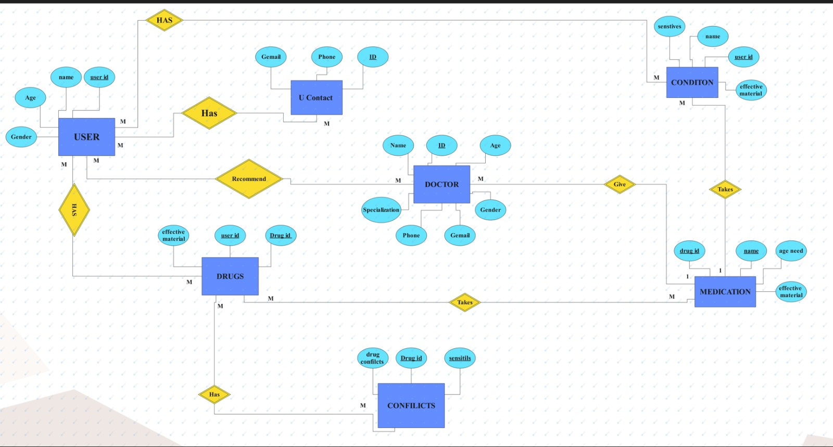

Slide 15
Database

Slide 16
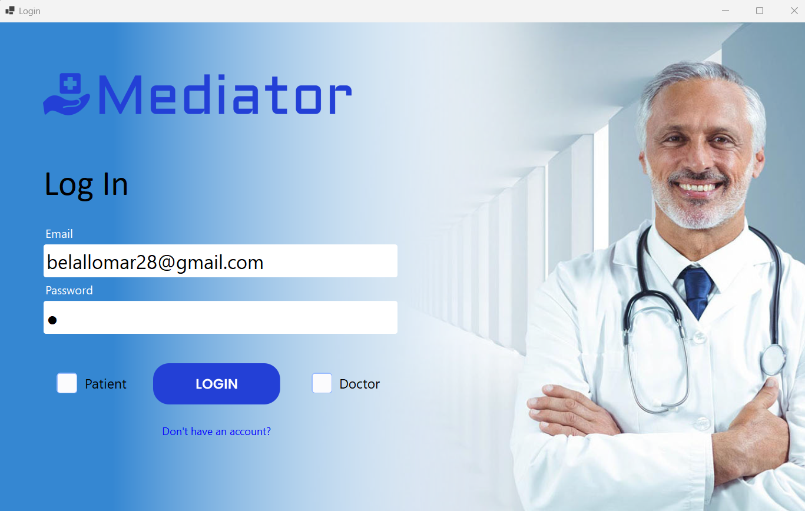

Slide 17
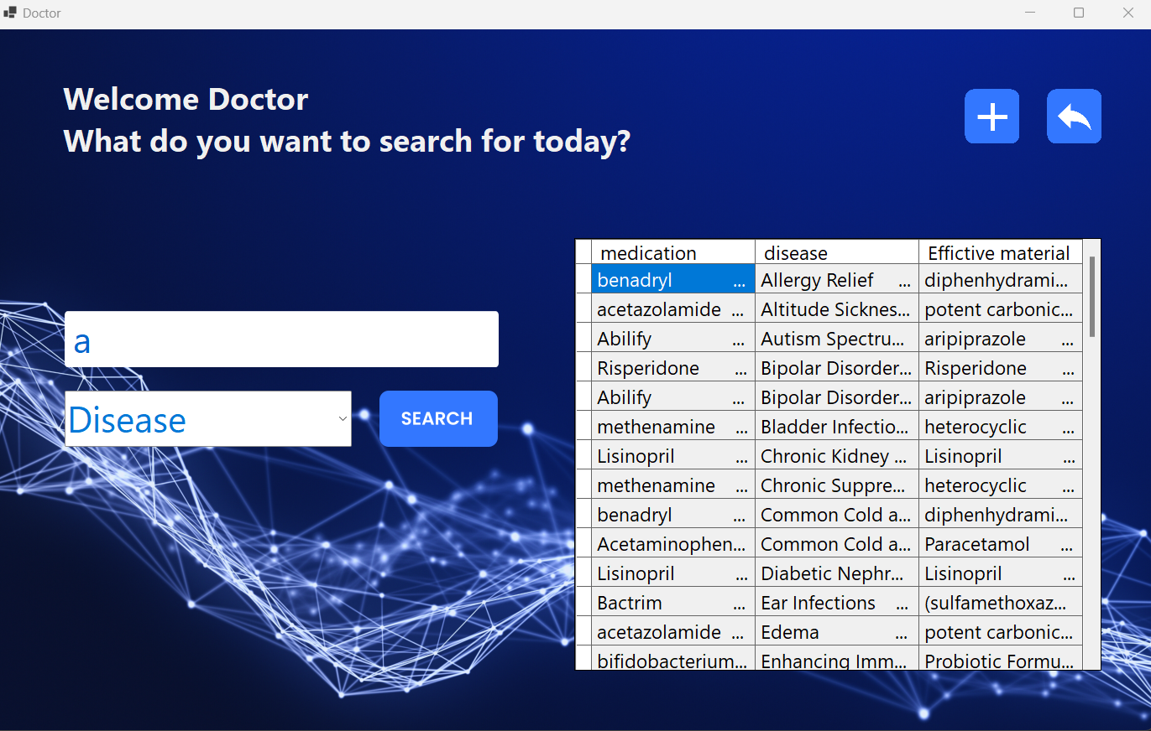
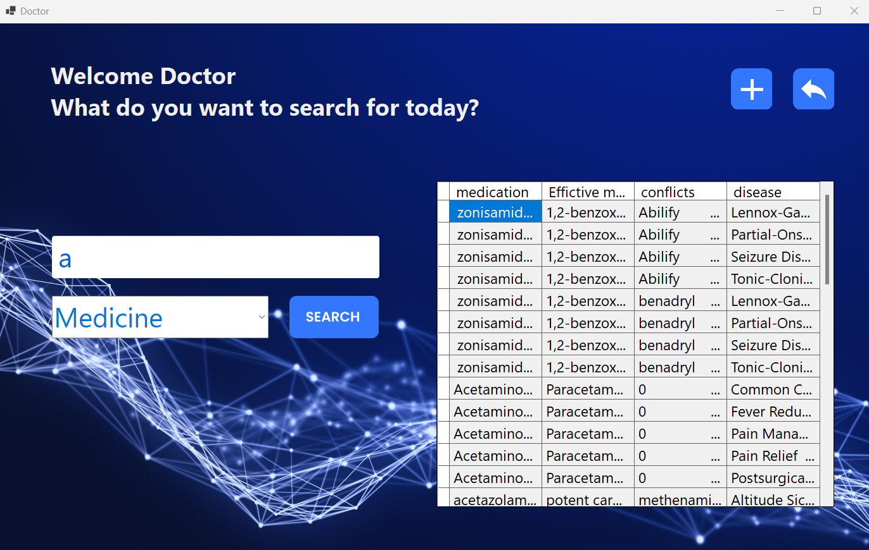

Slide 19
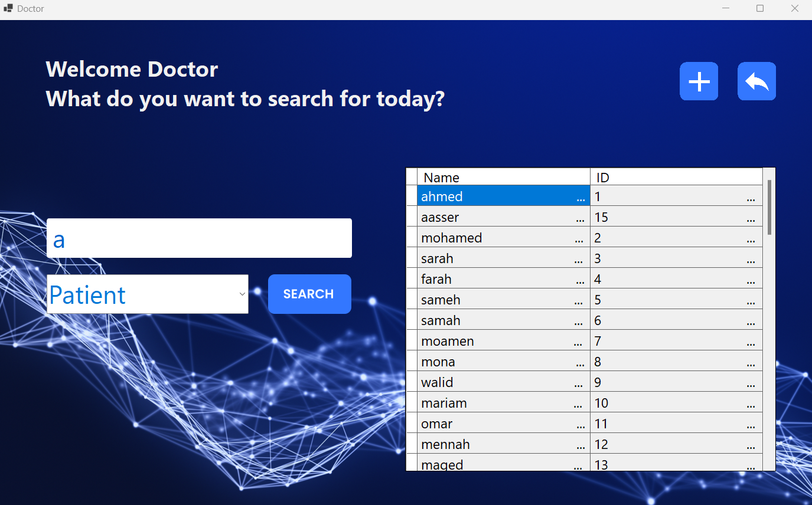

Slide 20
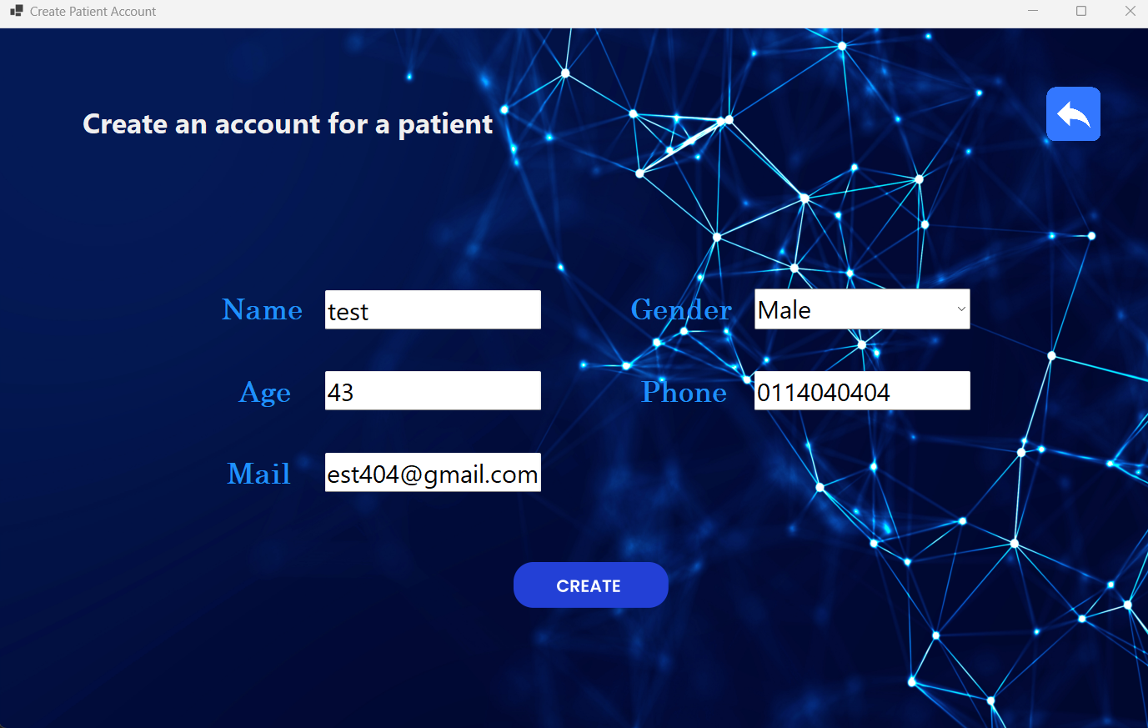
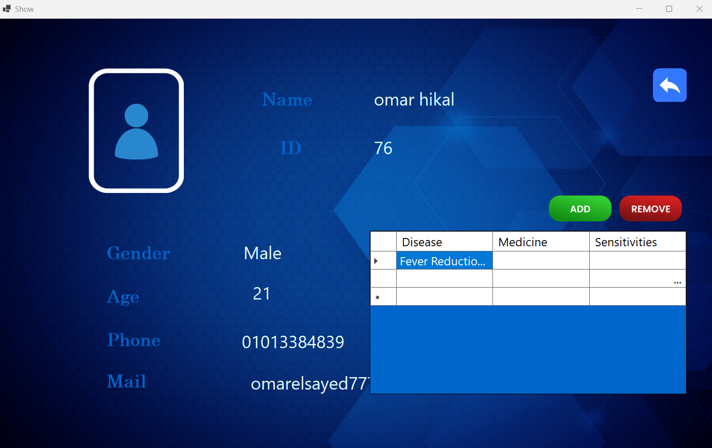
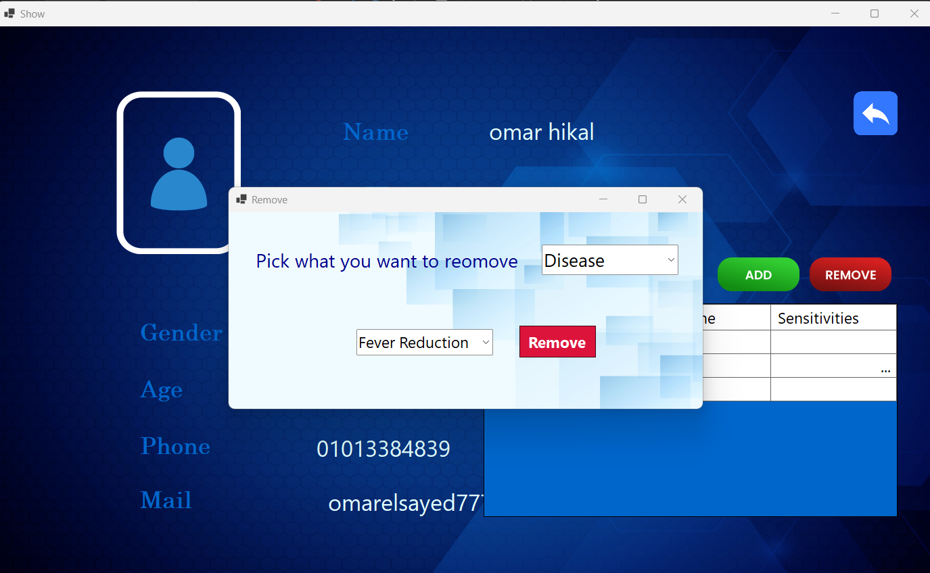
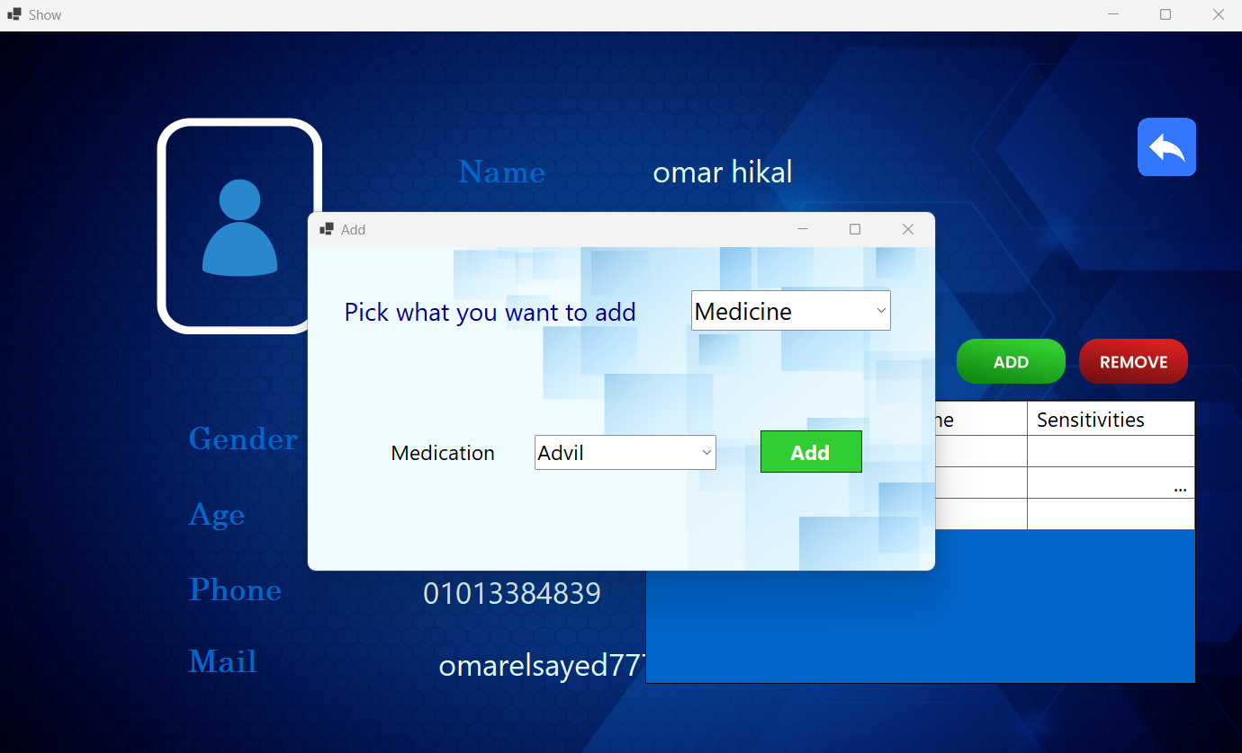

Slide 24
Results and next step

Slide 25
Results
Next step
A program to record the patient's medical record
Deploy the application in hospitals
Increasing the data set
for medications

Slide 26
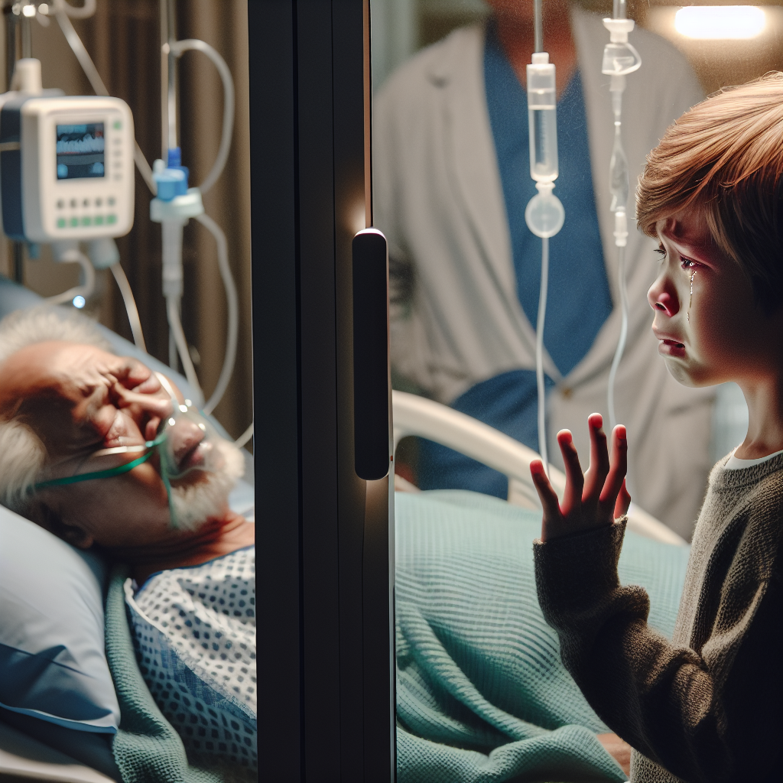
Our goal
Giving a life opportunity to someone who could have taken a conflicting medication
Someone died

Slide 27

Thanks

Slide 28

Brainstorming
To solve a problem facing people
We achieve our course objectives

Slide 29
Abdominal pain

Slide 30

The doctor forgot to ask
Or the patient gives an unclear answer

